Slide 1
.NET Aspire and observability

Slide 2
Hello!
I am Glenn Versweyveld
You can find me on
twitter @depechie
mastodon https://dotnet.social/@depechie

Slide 3

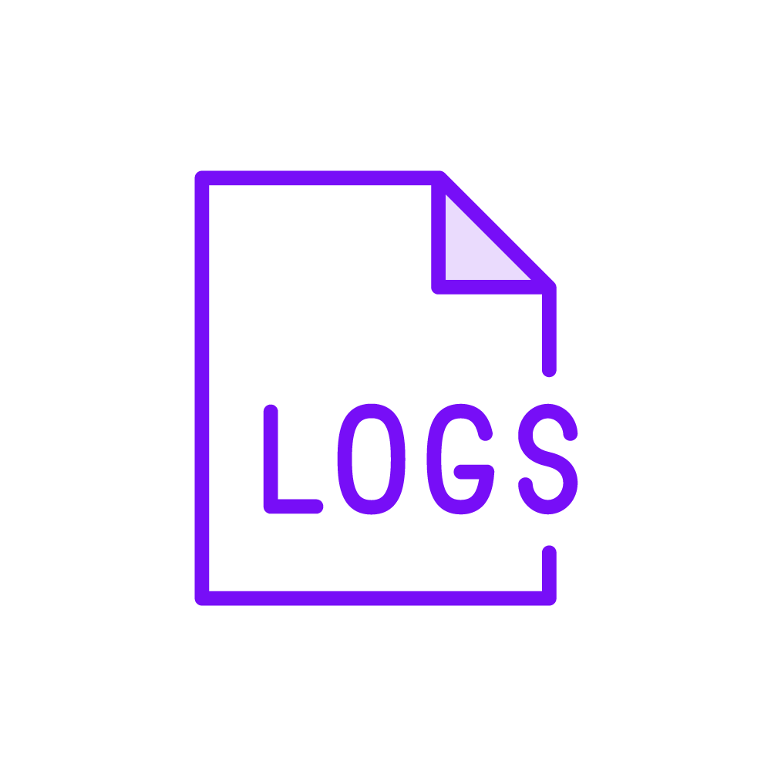

Observability parts and benefits
Monitoring
Capture and measure metrics
Gain insights into health and performance of the system
Logging
Record important events, actions and errors
Valuable for troubleshooting, auditing and detecting anomalies
Tracing
Capture and correlate execution path of a request
Reconstruct the end-to-end flow of a specific transaction

Slide 4

How does it work?
Follow an interaction by tagging it with an identifier. It stays with the transaction as it interacts with microservices, containers, and infrastructure. Offering visibility from the top of the stack to the application layer and the infrastructure beneath.
Solved by using OpenTelemetry
Notes:
To achieve the goal of being able to follow an interaction, we resort to using OpenTelemetry.
W3C tracing header

Slide 5

End-to-end request overview
Span ( user action ) – root span
Span ( front end )
Span ( API A )
Front end
API A
Span ( user API B )
API B
Database
Trace
Span ( Database )
Notes:
Messaging systems can also be a target

Slide 6
What is OpenTelemetry?
OpenTelemetry is a set of APIs, SDKs, tooling and integrations that are designed for the creation and transporting telemetry data such as traces, metrics, and logs.
OpenTelemetry.io
Notes:
It allows us to work in an uniform/standardised way, abstracting away the actual core work to achieve our goals.

Slide 7
What is it ‘OpenTelemetry’ not
It is not a data store
It is not a visualisation tool
It is not a data analytics or management environment

Slide 8
OpenTelemetry Instrumenting
The OpenTelemetry project facilitates the instrumenting of applications.
Instrumentation libraries offer a core repository per language. They may or may not offer additional repositories for automatic instrumentation or non-core components.
Examples:
.NET
Java
Go
Python
Rust
…
Notes:
Instrumenting | OpenTelemetry
Instrumentation | OpenTelemetry

Slide 9
OpenTelemetry Infrastructure
OpenTelemetry Protocol is a vendor and tool agnostic protocol specification: OTLP
Transmit telemetry data from the SDK
to a third party environment directly
Grafana, elastic, seq, datadog, splunk, …
through an OpenTelemetry Collector
.NET Aspire can act as such a third party environment
Notes:
Grafana
Elastic
https://docs.datadoghq.com/opentelemetry/interoperability/otlp_ingest_in_the_agent/?tab=host
https://www.splunk.com/en_us/solutions/opentelemetry.html
https://docs.datalust.co/docs/tracing-from-opentelemetry-sdks

Slide 10
What is .NET Aspire?
It provides an API to describe resources with their dependencies, and a runtime to resolve these dependencies.
This orchestration is intended to ease local development of distributed applications.

Slide 11
.NET Aspire terminology
App model
Collection of resources that make up your distributed app
Uses the builder pattern
App host
The project that orchestrates the app model
Resource
A dependent part of the app, a .NET project, container, executable, database, cache, or cloud service
Integration
NuGet package with tooling or service, like Redis, PostgreSQL, SQL Server
Reference
Defines the connection between resources

Slide 12
.NET Aspire setup
A dashboard is configured including a frontend and OpenTelemetry Protocol (OTLP) addresses, the resource service endpoint, authentication, telemetry limits, and more.
NET Aspire OTLP setup
DOTNET_DASHBOARD_OTLP_ENDPOINT_URL
This endpoint hosts an OTLP service and receives telemetry using gRPC
DOTNET_DASHBOARD_OTLP_HTTP_ENDPOINT_URL
This endpoint hosts an OTLP service and receives telemetry using Protobuf over HTTP

Slide 13
DEMO

Slide 14
OpenTelemetry Collector
The OpenTelemetry Collector offers a vendor-agnostic implementation of how to receive, process and export telemetry data.
Consists of three components:
receivers
processors
exporters
These components, once configured, must be enabled via pipelines within the service section.
Notes:
Collector | OpenTelemetry
The configuration is done in the OpenTelemetry Collector config YAML file

Slide 15
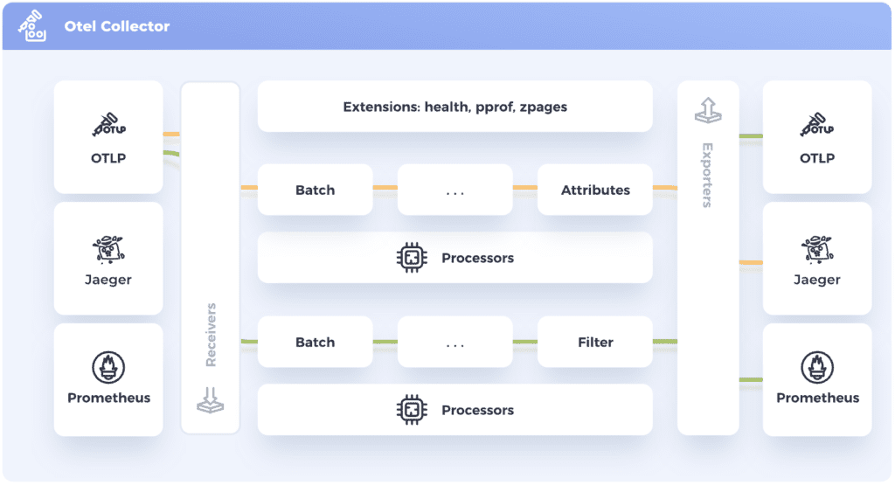
OpenTelemetry Collector
Notes:
The OpenTelemetry Protocol (OTLP) defines the encoding, transport, and delivery mechanism of telemetry data between telemetry sources, intermediate processes such as collectors and telemetry backends

Slide 16
DEMO

Slide 17
Thanks!
You can find me on twitter @depechie
mastodon https://dotnet.social/@depechie
https://github.com/Depechie/2024-visug-aspireotel
https://github.com/Depechie/OpenTelemetryGrafana
https://www.pluralsight.com/library/courses/opentelemetry-grafana-observability

